Slide 1

Turtle Games
This Photo by Unknown Author is licensed under CC BY-SA
Advanced Analytics for organization impact
“Custumer Loyalty & Segmentation Analysis”
LSE DA301
Student: Monica Baracho
Notes:
focusing on how customer and review data can help improve loyalty and sales performance.

Slide 2

Turtle Games Goal: Improve customer loyalty and overall sales performance
Key Obstacles:
Low visibility into loyalty drivers
Unclear high-value customer profiles
Unused review data containing valuable feedback
Our Business Question:
"How can Turtle Games use customer and review data to increase loyalty and target the right segments?"

Slide 3
Analytical Approach Overview
Dataset Preparation
The turtle_games.csv dataset was loaded and thoroughly cleaned using Python to ensure accurate analysis. Combined Python for data prep & EDA; R for modelling, prediction, and visualisation
Demographic Exploration
Exploratory analysis focused on customer demographics such as gender, age, remuneration, and education to identify trends.
Behavioural Analysis
Further analysis examined spending score, loyalty points, and review summaries to address business questions.
This Photo by Unknown Author is licensed under CC BY-SA

Slide 4
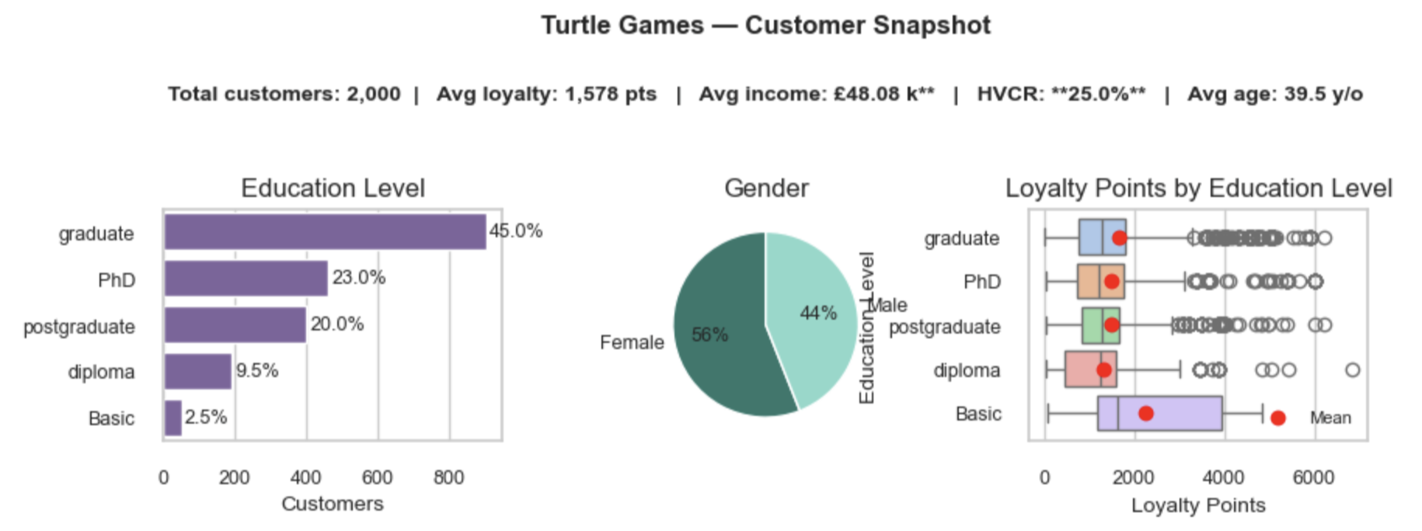
Customer Profile: Predominantly Female, Well-Educated, and Demonstrating Strong Loyalty
Notes:
The typical Turtle Games customer is a well-educated woman around 39 years old. 45% hold graduate degrees, and the average loyalty point level is around 1,578. This suggests a loyal and educated base, and opportunities for behavior-based segmentation.

Slide 5
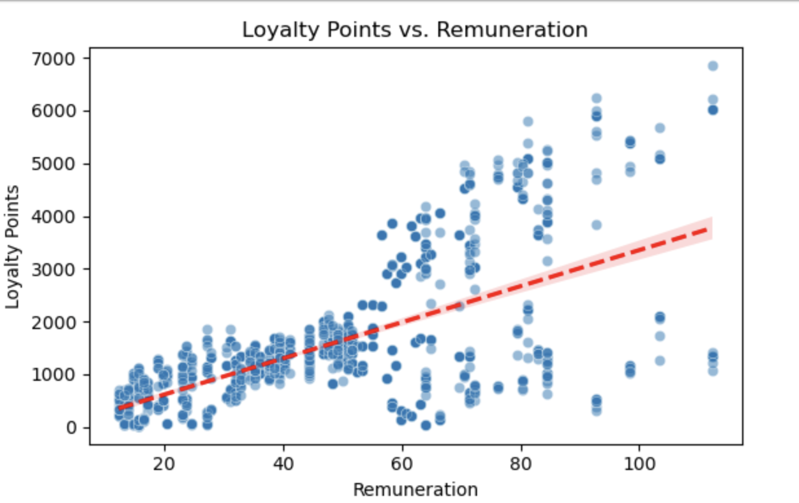
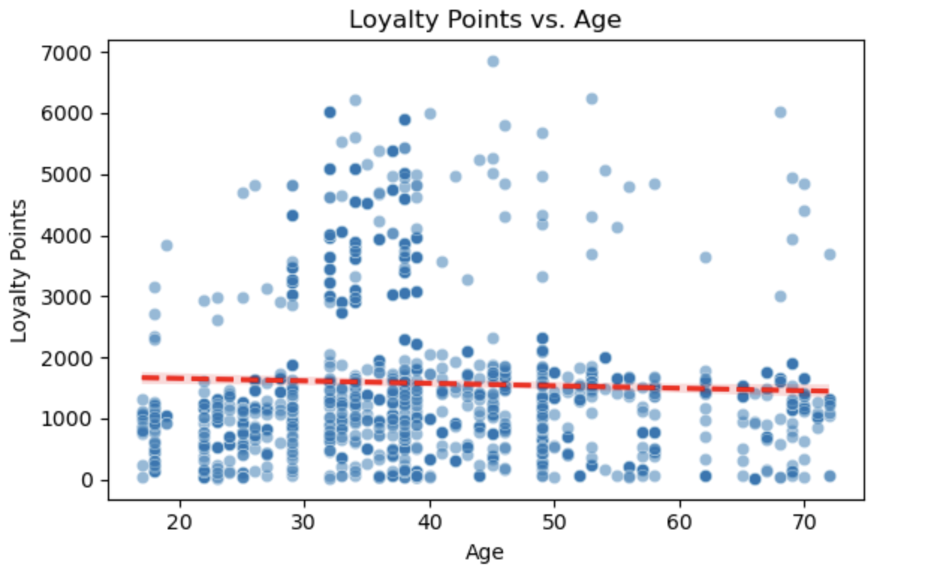
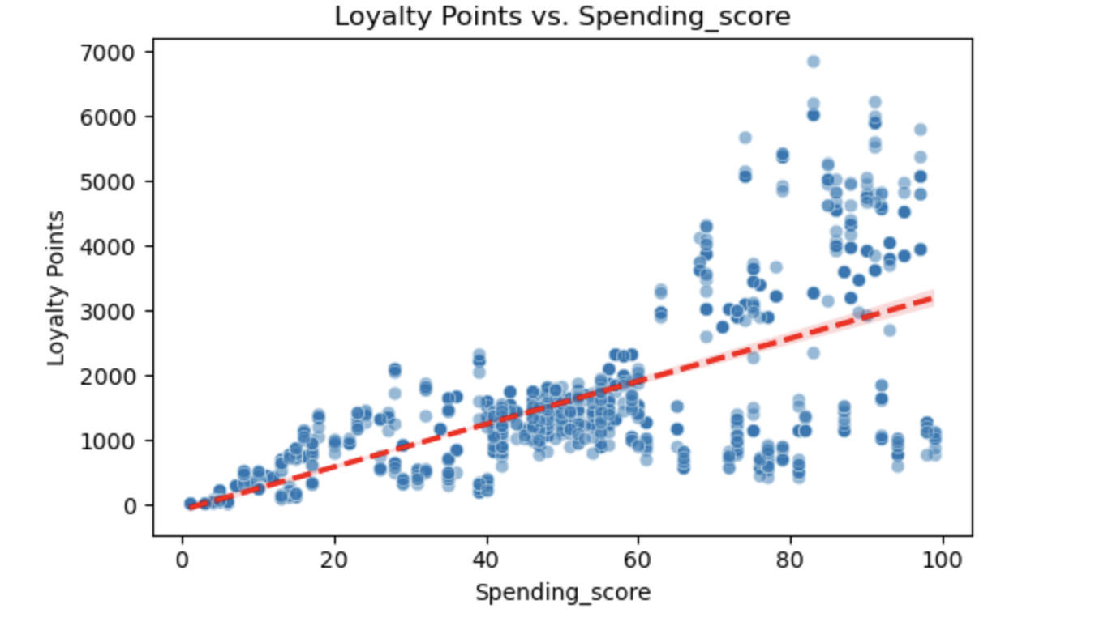
What influences loyalty points?
Clear positive trends for spending and remuneration; weaker link with age

Slide 6
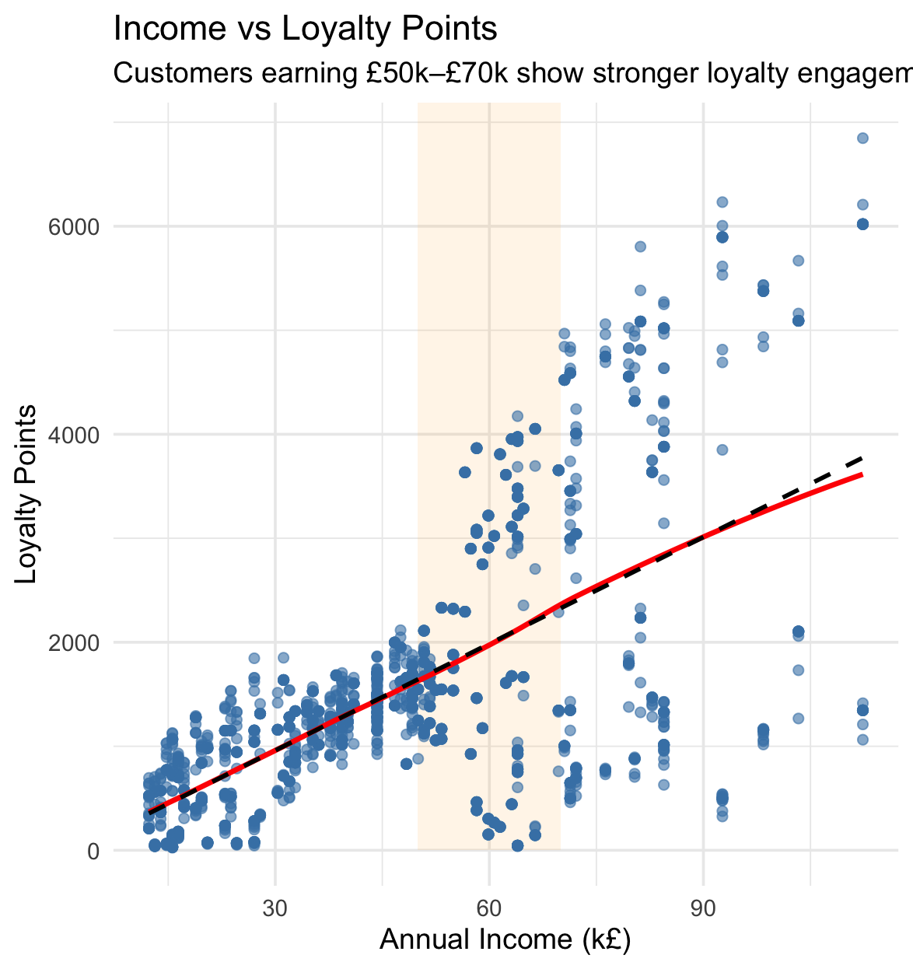
£50–70k income customers show high loyalty—ideal for targeted marketing
Notes:
A closer look shows that customers earning between £50k–£70k display the strongest loyalty. This segment is a key target for premium loyalty incentives and personalized communication."

Slide 7
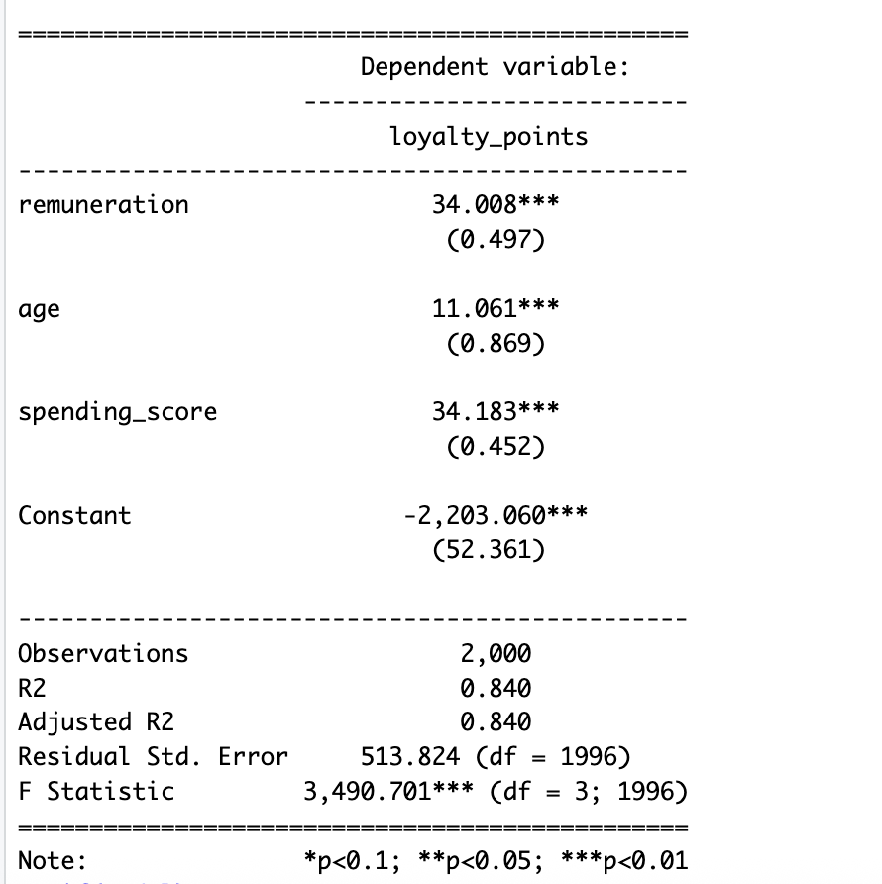
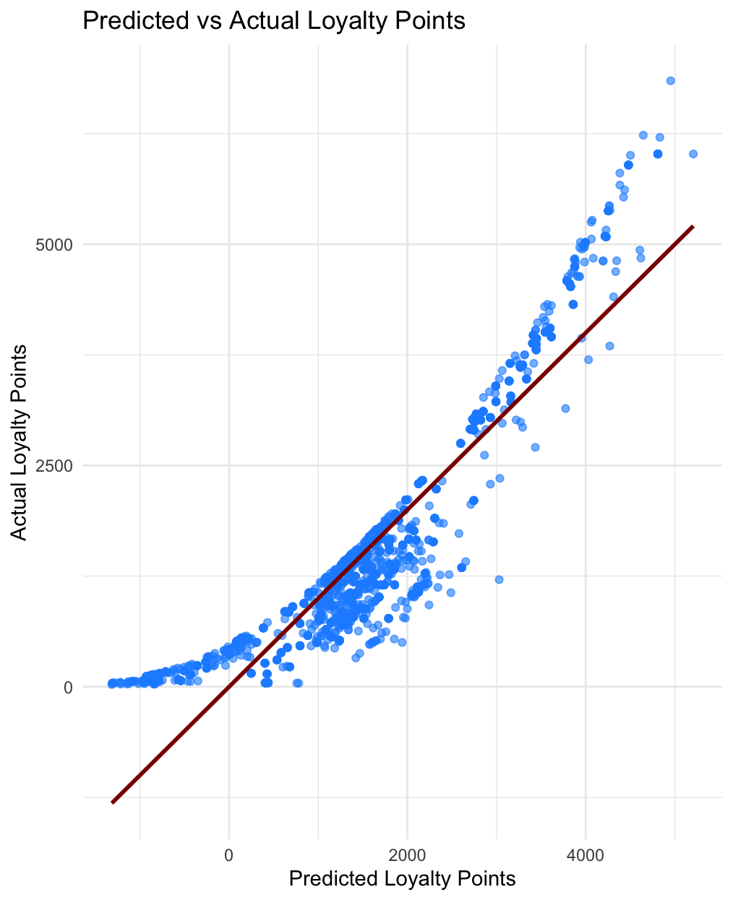
Model Performance and Insights
- High spending score and remuneration most strongly predict loyalty.
- Age has smaller yet significant positive impact.
R² = 0.84 → excellent model fit.

Slide 8
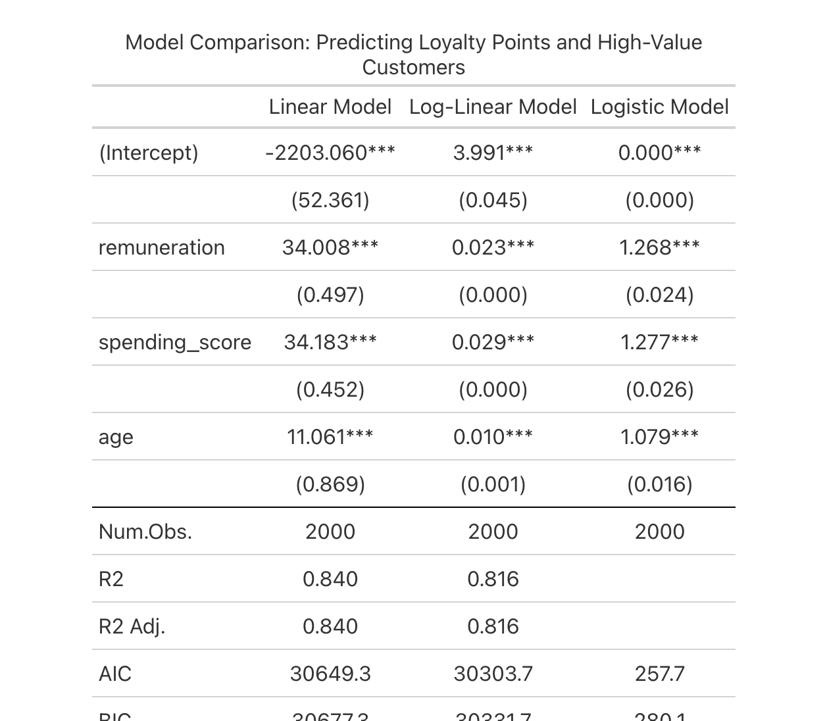
Model Comparasion Insights
Notes:
We compared linear, log-linear, and logistic models. All show consistent variable importance. The logistic model helps classify high-value customers, with an AUC of 0.996. This enables smarter targeting for loyalty campaigns.

Slide 9
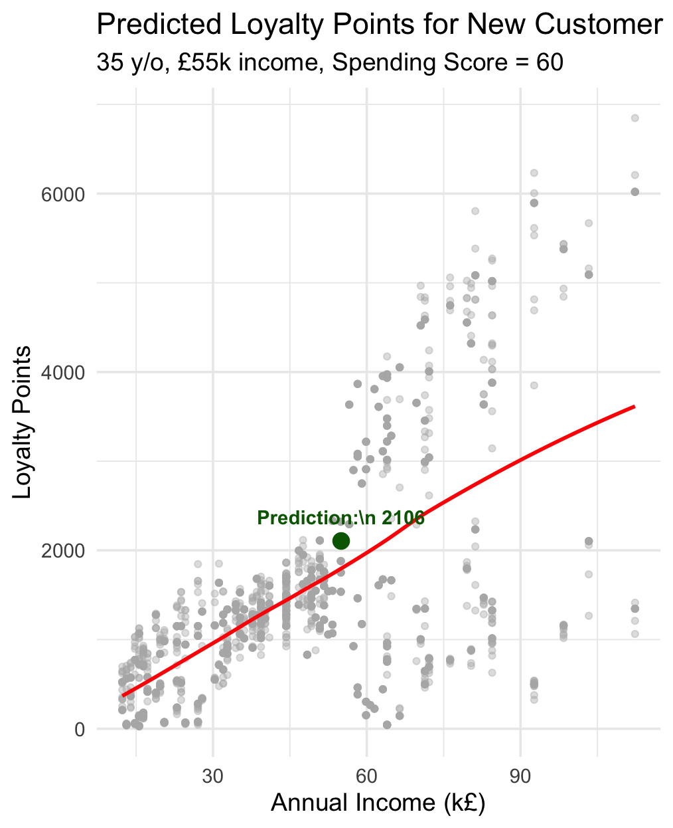
Forecasting Loyalty for New Customers
A typical new customer (age 35, income £55k, spending score 60) is forecast to earn ~2,100 loyalty points.
Notes:
We also forecast loyalty for new customers. For instance, a typical 35-year-old earning £55k with a spending score of 60 is predicted to earn ~2,100 loyalty points. This helps anticipate engagement from new segments."

Slide 10
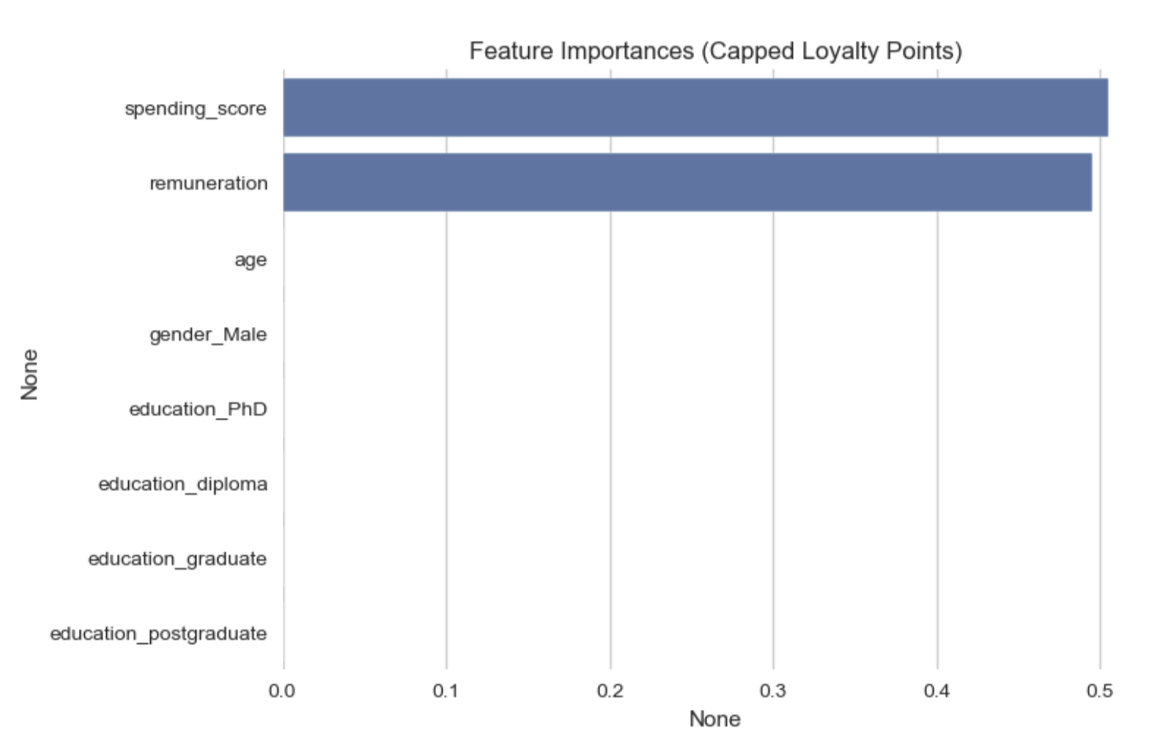
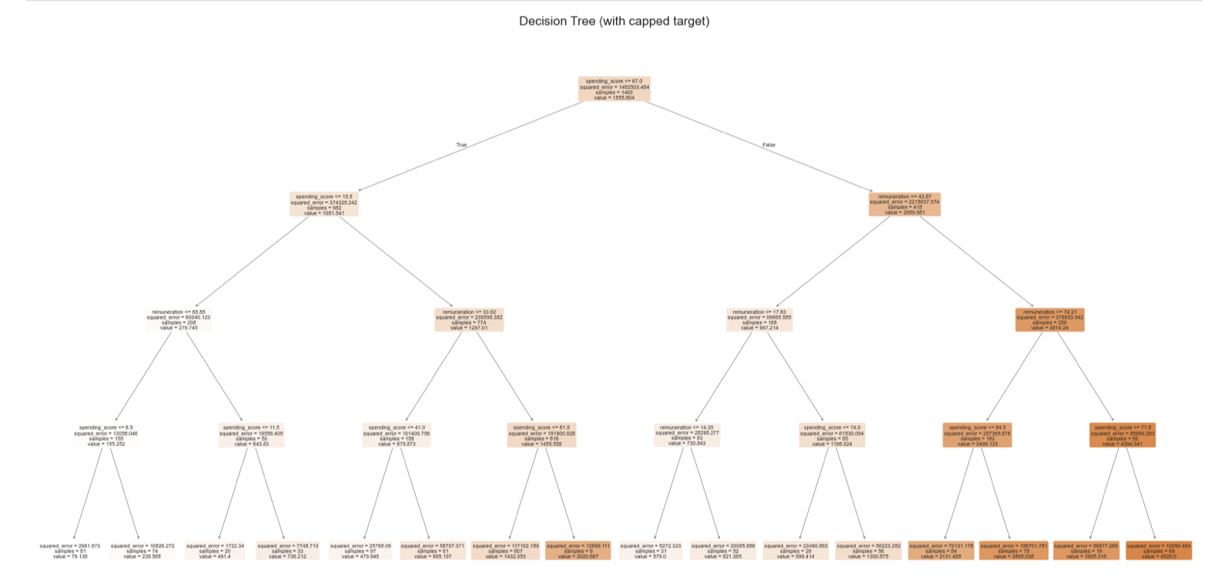
Decision Tree Insights: Key Drivers of Loyalty
Notes:
To complement regression, we used a decision tree model to uncover patterns. Spending score and income again dominated. The tree helps segment customers with targeted offers by rules like 'high income but low spend'

Slide 11
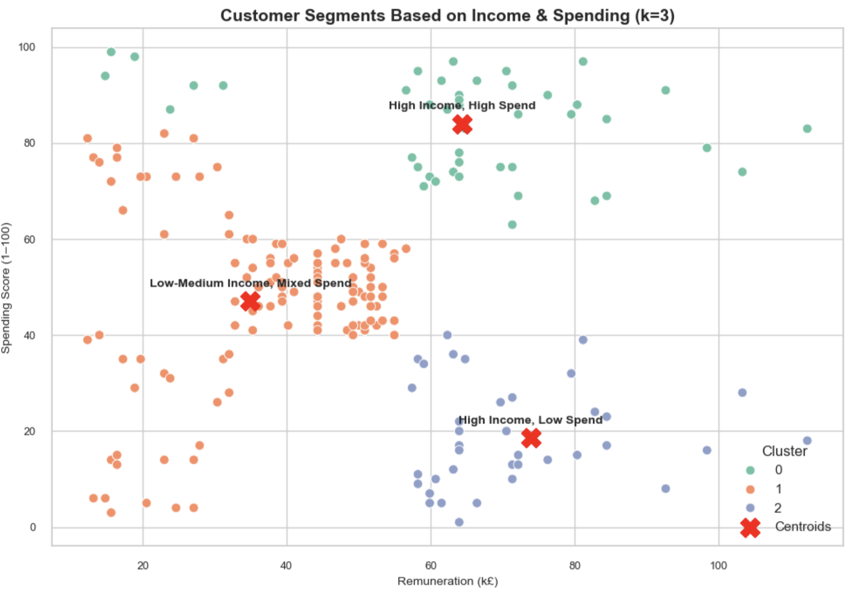
Customer Segments Based on Income and Spend (K-Means) Three distinct customer groups reveal opportunities for tailored strategies.
We used K-means clustering to group customers based on income and spending score.
The plot clearly separates them into three key segments:
🟢 High-income, high-spenders — our most commercially valuable customers. 🟠 A large mixed group with lower income but varying spend — offering volume potential. 🔵 And a high-income group that spends surprisingly little — a potential missed opportunity.
Notes:
We used K-means clustering to group customers based on income and spending score.
The plot clearly separates them into three key segments:
🟢 High-income, high-spenders — our most commercially valuable customers. 🟠 A large mixed group with lower income but varying spend — offering volume potential. 🔵 And a high-income group that spends surprisingly little — a potential missed opportunity.
These insights help us build smarter, more tailored marketing strategies — rather than a one-size-fits-all approach.”

Slide 12
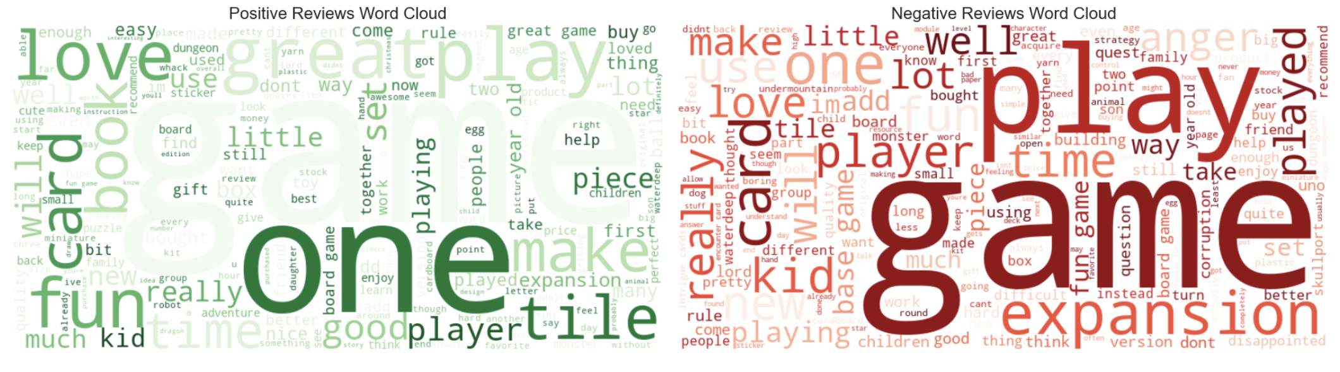
Customer Sentiment: What Words Define the Experience? Positive vs. Negative Word Clouds from 2,000+ Reviews

Slide 13
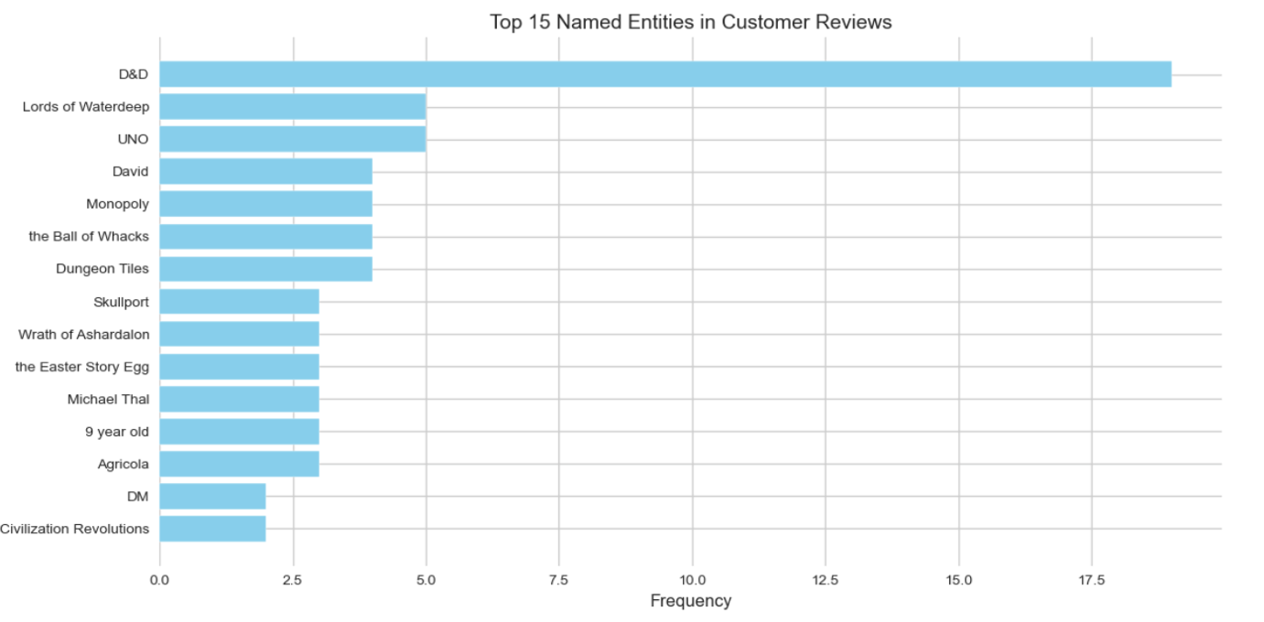
Recommendations from Customer Review Mentions
Insight | Action
D&D dominates brand recall | Create themed loyalty rewards & fantasy campaigns
UNO & Monopoly mentioned frequently | Build cross-brand bundles & email campaigns
Specific characters and ages mentioned | Tailor offers by age range and product theme
Strong engagement with named entities | Reinforce titles with high recall in ads and bundles

Slide 14
Strategic Recommendations: Turning Insights into Action
Insight Area | Strategic Recommendation
Income–Loyalty Link | Focus on £50k–£70k income customers
NER: Top Product Mentions | Promote D&D/fantasy-themed bundles and loyalty incentives
Word Cloud – Neg Sentiment | Improve expansion content and rule clarity
Word Cloud – Pos Sentiment | Market joy, gifting, and tactile quality
Gender/Education Analysis | Prioritise behaviour-based segmentation

Slide 15
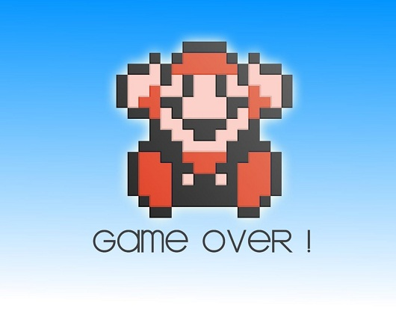

Thank you!!!
This Photo by Unknown Author is licensed under CC BY-SA-NC

